Slide 1
Title I Annual Parent Meeting
Overview of the Title I Schoolwide
Program at
Mater Lakes Academy Middle/High
September 22nd 2020
5:45 PM
Zoom ID: 995-164-9978
Rene Rovirosa
Notes:
Note: This presentation may be utilized for virtual and in person meetings. All schools are required to update the presentation with the school’s information (see highlighted sections on each slide). Schools are encouraged to insert pictures/graphics/videos into their virtual presentation. During the virtual meeting, presentation, parents and families should be encouraged to provide input and feedback. The presenter may ask questions, provide an opportunity for responses and read aloud some of the responses provided. Please designate someone to take meeting minutes that can later be made available to parents/families on school website and is kept in the Title I Compliance filing system.

Slide 2
Agenda
Welcome and Introductions All About Title I Title I Schoolwide Funds Title I District-level Parent and Family Engagement Plan (PFEP) Title I School-level PFEP School Improvement Process (SIP) School Achievement and Performance Data Title I School-Parent Compact Parents, Families, and Schools Working Together | 10. Parent’s Right-to-Know 11. Curriculum, Instruction & Assessment 12. Coordination with Other Federal Programs 13. Consultation and Compliant Procedures 14. School-level Parent and Family Engagement Survey 15. Availability of the Title I District and School-level PFEP, SIP and School- Parent Compact 16. Project UP-START 17. School Contact Information 18. Questions/Answers
Notes:
Note: Slide #1 and #2 (2 slides per page) should be printed and placed in folder VI.3 and VI.6 (in corresponding month) of the Title I School-level Compliance Filing system.

Slide 3
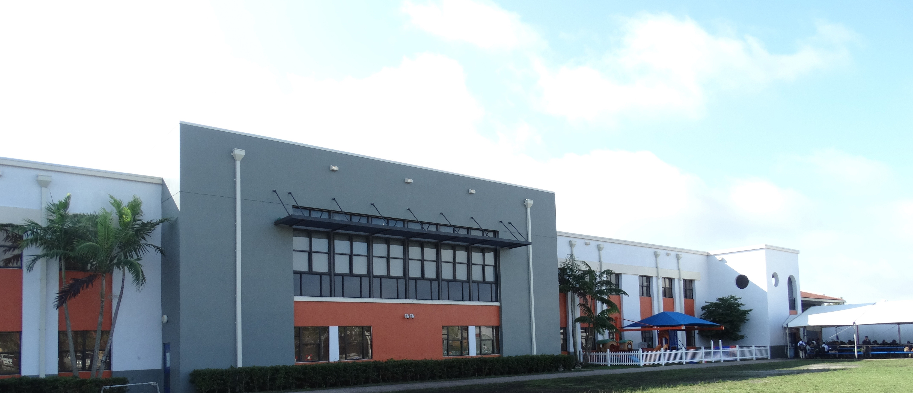
Purpose of Meeting
Federal guidelines require Title I schools to hold an Annual Parent Meeting to explain and discuss the Title I Schoolwide Program requirements.
Mater Lakes Academy Middle/High is a Title I School.
Notes:
If possible, include a welcome message on your marquee for students, parents & families. You may also include a slide showing the school marque message.

Slide 4
All About Title I
Title I is the largest federally funded education program under the Every Student Succeeds Act (ESSA) designed to provide students with additional help in Reading, Language Arts, Mathematics, Science and Social Studies. Its main objective is to support schools and districts in order to ensure that highly quality education is equitable for all students.
The Title I Schoolwide Program is committed to helping schools close the achievement gap between disadvantaged and minority students and their peers.
To learn more, please visit http://title1.dadeschools.net. This site is designed to supply users with information relevant to Title I, in order to provide a clear understanding of the overall program.
Notes:
Allow parents to provide input/enter comments/questions. The presenter may use this opportunity to ask meeting participants questions ex. How many of you have heard of the Every Student Succeeds Act (ESSA)? (answer: yes/no)Does anyone know when it was signed into law? (answer: 2010).

Slide 5
The Every Student Succeeds Act (ESSA) Title I Parent and Family Engagement Requirements
The School District and all Title I schools must allocate a portion of their Title I budget towards programs, activities, and procedures for parent and family engagement.
The School District and all Title I schools must develop with, and distribute to parents and family members a written Title I Parent and Family Engagement Plan (PFEP).
All Title I schools are required to collaborate with parents and families in the development of the School Improvement Process (SIP) and School-Parent Compact.
[https://tinyurl.com/SchooParentCompact
Notes:
Inform meeting participants that the 2020-2021 Title I School-level PFEP, District-level PFEP, SIP, and School Parent Compact are located on our school’s website. Allow the opportunity for parents/families to enter their comments. Read aloud some of the responses.

Slide 6
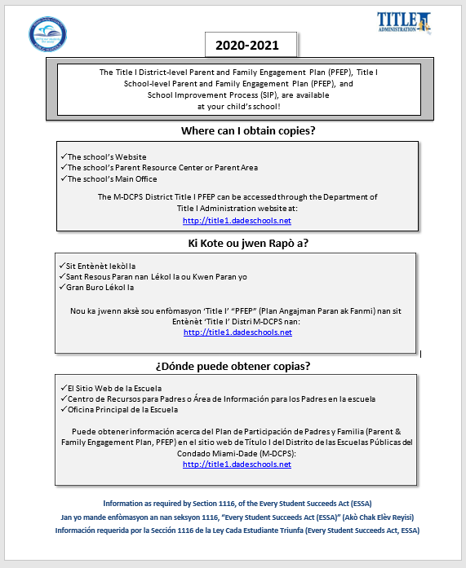
Availability of Compliance Documents Title I Notification Flyer
Notes:
Inform meeting participants of the availability of the Title I Notification Flyer posted on the school’s website and at title1.dadeschools.net. Provide directions for accessing the flyer.

Slide 7
Title I Schoolwide Funds
A portion of Title I Schoolwide Funds are used to fulfill the parent and family engagement requirements in the ESSA law and provide supplemental materials and resources. Educational Excellence School Advisory (EESAC) is the official forum to discuss the details of Title I funding.
Schoolwide Funds for Middle (6033)
- Amount of funds available for this year: $_294,363.00
Title I Parent and Family Engagement Funds
- Amount of funds available for this year: $ 5,788.00
Funds usage: Teachers, supplies, software such as ,iReady, USA Test Prep, Noredink, McGraw-Hill, Edgenuity, Math XL
Notes:
Inform meeting participants that they may view additional information on how Title I funds are utilized in the Title I Handbook located on the Title I website under Compliance. Provide calendar/schedule of EESAC meetings to meeting participants and invite them to attend. Allow parents/families an opportunity to enter their comments. Read aloud some of the responses.

Slide 8
Title I Schoolwide Funds
A portion of Title I Schoolwide Funds are used to fulfill the parent and family engagement requirements in the ESSA law and provide supplemental materials and resources. Educational Excellence School Advisory (EESAC) is the official forum to discuss the details of Title I funding.
Schoolwide Funds for Middle (7018)
- Amount of funds available for this year: $_294,796.00
Title I Parent and Family Engagement Funds
Amount of funds available for this year: $ 5,796.00
Funds usage: Teachers, supplies, software such as ,iReady, USA Test Prep, Noredink, McGraw-Hill, Edgenuity, Math XL
Notes:
Inform meeting participants that they may view additional information on how Title I funds are utilized in the Title I Handbook located on the Title I website under Compliance. Provide calendar/schedule of EESAC meetings to meeting participants and invite them to attend. Allow parents/families an opportunity to enter their comments. Read aloud some of the responses.

Slide 9
Title I District-level PFEP
The District-level PFEP is a blueprint of how the District Local Educational Agency (LEA) and Title I schools will work together with parents and family members to establish expectations for family engagement and strengthen student academic achievement.
The District-level PFEP describes how the District will:
provide the coordination, technical assistance, and other support actions to assist schools in planning and implementing effective parent and family engagement activities.
conduct, with meaningful involvement of parents and family members, an annual evaluation of the content and effectiveness of the parent and family engagement plan towards improving the academic quality of all schools served under Title I, Part A.
Notes:
Schools may include a link to the Title I District-level PFEP on this slide and provide directions for accessing it on the school’s website.

Slide 10
Our Title I School-level PFEP
The School-level PFEP is a blueprint of how Mater Lakes Academy Middle/High will work together with parents, family members, and the community to establish expectations for family engagement and strengthen student academic achievement.
Describes how the school will:
Convene an annual meeting to inform parents and family members of their rights to be involved in the Title I program;
EESAC meetings are conducted every other month the second Tuesday of the month allowing for flexible scheduling.
Notes:
Allow meeting participants to provide feedback on the information presented. Share with parents how the virtual meetings will be conducted. At this time you may provide an opportunity for meeting participants to share how they prefer to receive information from the school.

Slide 11
Our Title I School-level PFEP (Contd.)
Describes how the school will:
Provide parents and family members with timely information about Title I programs;
School Messenger (Phone and Email correspondence)
Flyers sent home
School Website (www.materlakes.org)
School Social Media (Facebook, Instagram, Twitter)
Involve parents, in an organized, ongoing, and timely manner, in the planning, reviewing, and improvement of schoolwide activities and involve parents and families in the planning, reviewing, and improvement of documents required by the Title I Program such as: the Title I School-level PFEP, the School-Parent Compact, and the joint development of the Title I schoolwide program plan (School Improvement Process [SIP]);
PTSO, EESAC
Participate in school functions, serving as volunteers, assist in teacher appreciation week, family and fun functions (events), FAFSA trainings, University presentations. Senior and Junior parent night.
Notes:
At this time you may provide the opportunity for the ESSAC Chairperson to greet meeting participants and invite them to the next ESSAC Meeting. EESAC representative should inform meeting participants how they may access the EESAC calendar for upcoming meetings and provide information/directions for virtual meetings, as applicable.

Slide 12
Our Title I School-level PFEP (Contd.)
Describes how the school will:
Assist parents and families in understanding academic content standards, assessments, and how to monitor and improve the academic achievement of their children; and
Parent Teacher Conferences held quarterly and as needed, EESAC meetings, Gradebook/Portal, Our new platform Colegia.
Provide training to assist parents and families of students enrolled in schools implementing the Title I Schoolwide Program to improve their child’s academic achievement.
Tutoring Programs, Parent Academy, CAP (College Advisory Program)
Notes:
Schools may share the new platform My School Online (MSO) with meeting participants . You may take this opportunity to survey meeting participants to inquire if they have assisted their children with utilizing MSO.

Slide 13
Our School Achievement Data
Our school uses data to align the curriculum to State and District academic standards.
Our instructional practices are adjusted based on the findings of the assessment data.
For further details about our school achievement data, we invite you to attend the EESAC meetings throughout the school year.
Notes:
Allow the opportunity for meeting participants to provide input/feedback. You may ask questions based on the information discussed.

Slide 14
Our School Improvement Plan (SIP)
Our School’s Mission Statement
The Vision of Mater Lakes Academy, Inc. is to provide students a viable educational choice that offers an innovative, rigorous, and seamless college preparatory curriculum, providing Mater students, at every level from PK-12th grade, with a competitive advantage against their contemporaries. To that end, Mater Schools strive to:
create a thirst for knowledge in all disciplines;
kindle the art of thinking and serve as a springboard for lifelong learning; and
deliver and enrich every student with a sense of purpose, a belief in their own efficacy, and a commitment to the common good.
Our School’s Goal for 2020-2021
G1. If core instruction is increased in all content areas then student achievement will improve: Middle
ELA: From 71% to 78% Civics EOC: From: 79% to 83%
Math: From 74% to 79% Math EOCs: From 95% to 97%
Science: From 42% to 48% Biology EOC: From 90% to 93%

Slide 15
School-Parent Compact
Each Title I school must have a School-Parent Compact that is developed jointly by parents and school personnel.
The compact sets out the responsibilities of the students, parents, and school staff in striving to raise student academic achievement.
At the elementary grades (K- 5 only), the compact should be discussed and amended during parent-teacher conferences and documented in a teacher communication log.
https://tinyurl.com/SchooParentCompact
Notes:
Review and discuss the School-Parent Compact with meeting participants and allow time for feedback/comments.

Slide 16
School and Parent Collaboration
Our school offers workshops, training, and parent/teacher conferences at flexible meeting times such as our virtual open house, scheduled for September 23rd 2020 at :30 PM. In addition, our parent resources center is available M-F between the hours of 8:30 AM and 3 PM.
School and parent partnerships are built within advisory councils such as the Educational Excellence School Advisory Council (EESAC), District Advisory Council (DAC), and Parent Advisory Council (PAC);
Title I DAC and Region PAC members are representatives of parents who consult with the District Title I DAC about the planning and implementation of the Title I Schoolwide Program; and
Notes:
Inform meeting participants of the method the school will utilize to inform parents/families of upcoming meetings, etc. Describe how meeting notices/invites (including virtual meetings) will be sent/made available to parents/families. Describe how the school will keep all parents informed, specifically parents who may be unable to attend virtual/in person meetings (ex. archived virtual meetings).

Slide 17
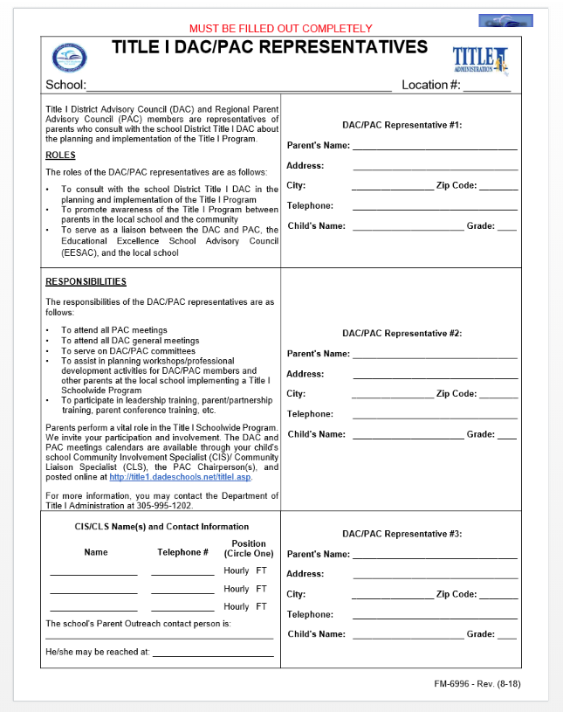
School and Parent Collaboration (Contd.)
The school conducts elections for DAC/PAC representatives.
Notes:
Inform meeting participants that the Title I District Advisory Council and Parent Advisory Council Meetings will be conducted virtually. Additional information regarding the Title I DAC and PAC meetings will be forthcoming. Encourage meeting participants to visit the Title I Website for additional information regarding the Title I DAC and PAC.

Slide 18
Parents Right-to-Know
Parents have the right to request and receive timely information regarding the professional qualifications of their child’s teachers and paraprofessionals.
Parents must be notified if their child is assigned to, or taught, by a teacher who does not meet state certification requirements for the grade level or subject area for four (4) or more consecutive weeks.
Parents should be provided information regarding the level of academic achievement of their child on State required academic assessments.
To the extent that it is feasible, information must be in a language that parents can understand.
Notes:
Inform meeting participants how each Parents Right-to-Know communication will be provided by the school.

Slide 19
Coordination with Other Federal Programs
Title III
Project UP-START
Migrant
Mater Lakes Academy coordinates with parents/families through our website as well as our social media platforms (e.g., Instagram, Facebook and Twitter). All programs and activities, times and dates are communicated with the opportunity for parent engagement.

Slide 20
School-level Parent and Family Engagement Survey
Please complete the 2020-2021 Title I School-level Parent and Family Engagement Survey located at https://tinyurl.com/SchooParentCompact in order to assist with the implementation of a Title I Schoolwide Program that meets the needs of your family.
The results of this survey will be utilized to help in the development of the Title I School-level Parent and Family Engagement Plan (PFEP), and
Future parent and family engagement activities, events, and workshops at Mater Lakes Academy Middle/High
Notes:
Encourage meeting participants to complete and submit the 2020-2021 Title I School-level Parent and Family Engagement Survey. Inform parents/families how they may gain access to the survey in multiple languages and the method for the submission of the survey. Share link to survey on the school’s website.
Note: The CIS/CLS (or School-level Compliance Facilitator in the absence of a CIS/CLS) will complete Compilation of Survey Results using template from Title I Collaboration Site – Folder VI.4.

Slide 21
Consultation and Complaint Procedures
Consultation and Complaint Procedures
A formal allegation regarding a violation of federal law and state regulatory guidance pertaining to the District’s delivery of Title I services and programs to non-public schools 16 may be filed in writing within 30 days of the incident and should specifically state the facts about the alleged action(s) and the provision of law or rule being violated. Such a complaint must be forwarded to: Dr. Eduardo M. Barreiro, Executive Director Title I Administration Miami-Dade County Public Schools 28205 S.W. 124 Court Suite F007 Homestead, FL 33033
2. The Executive Director should hold a meeting with the Complainant within 10 business days upon receipt of such notice. The Executive Director shall make every effort to review the allegations and resolve the matter to the satisfaction of the Complainant. A written notice of the resolution or non-resolution of the matter shall be forwarded to the Complainant.
Notes:
Administrator will provide brief overview of the chain of communication for complaint procedures as referenced in the 2020-2021 Title I Handbook.

Slide 22
Consultation and Complaint Procedures
3. If no resolution can be reached, the complainant may appeal the determination with the Administrative Director, Title I Administration and Federal/State Fiscal Operations. The appeal will be presented to the Assistant Superintendent, Division of Student and Family Support Programs. A written Notice of Outcome of the appeal will be furnished to the complainant.
4. If no satisfaction can be reached with the Assistant Superintendent, the Complainant may appeal in writing the determination with the Chief Academic Officer. 5. If the Complainant feels that his complaint with the District has not been resolved to his /her satisfaction, the individual may file a complaint with the Florida Department of Education (FDOE) Ombudsman, providing the basis for the complaint.

Slide 23
Project UP-START seeks to ensure a successful educational experience for children and youth living with unstable housing in Miami-Dade County.
Project UP-START

Slide 24
Every Student Succeeds Act (ESSA) McKinney-Vento Act
Project UP-START
What is Project UP-START?
Provides additional support services to any student who is currently experiencing unstable housing.
Identification;
Enrollment;
Attendance; and
Academic support

Slide 25
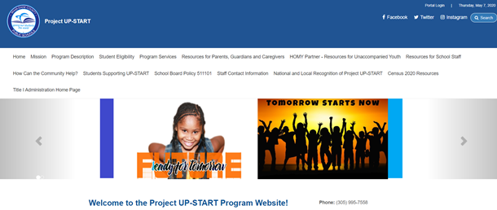
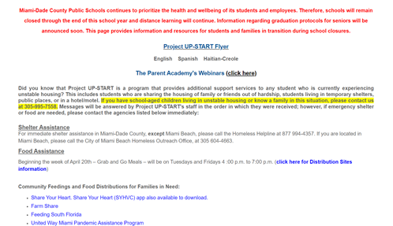
Project UP-START Resources
Website
Mandatory School Closures
Project UP-START Informational Page
@projectupstart
@projectupstart
@projectupstart
Notes:
Please visit the Project UP-START website for up-to-date information regarding Project UP-START. During the closure of school due to COVID-19 pandemic, Project UP-START staff have been working remotely but were still responding to all inquiries as received by telephone and email. Current hours of operation for the Shop may limited, so please call the Project UP-START office at 305-995-7558 or via email at projectupstart@dadeschools.net for available times to pick up items.

Slide 26
Project UP-START
Project UP-START
305 995-7318
305 995-7558 305 995-7583
Fax: 305 579-0370
Projectupstart@dadeschools.net
Monday-Friday: 8:00 am - 4:30 pm
Follow us @projectupstart
http://projectupstart.dadeschools.net
Notes:
-Please call the Project UP-START office before visiting to schedule an appointment.

Slide 27
School Contact Information
Mr. Rene Rovirosa
Principal
Mrs. Alice Martine
Assistant Principal
Mrs. Marjorie Enriquez
Assistant Principal
Mr. Steven Burgos
Assistant Administrator
Notes:
Allow school staff to greet parents/families. Strongly suggest to insert pictures as this is a virtual meeting and parents and families may be able to view this presentation later if archived.

Slide 28
Questions
Thank You for Your Participation!
Notes:
Address question and concerns from meeting participants. Inform meeting participants how the school will respond to all questions/concerns posed during the meeting, if time does not permit to answer all questions during the designated meeting time.

Slide 29
Comments/Feedback
Notes:
Save attendance documents, comment, feedback that were submitted via the virtual meeting.

Slide 30
Notes:
Thank you for your continued support of the Title I Schoolwide Program.

